Slide 1
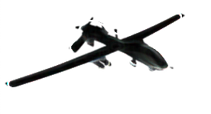



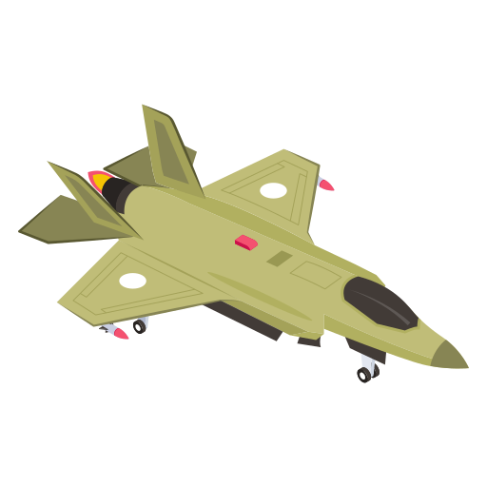
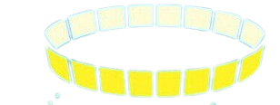







ASE6104 Capstone Final Presentation
Multi-Tactical Data Link Architecture (MTA) Analysis Tool
Team 3
Roger Campbell
David Chomyn
Kwasi Darkwah
Fareeha Rahman
Aaron Seemungal
Michael Whatley

Slide 2
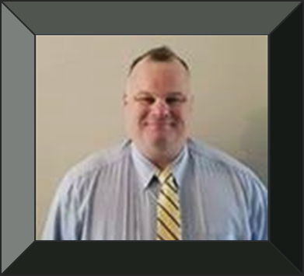





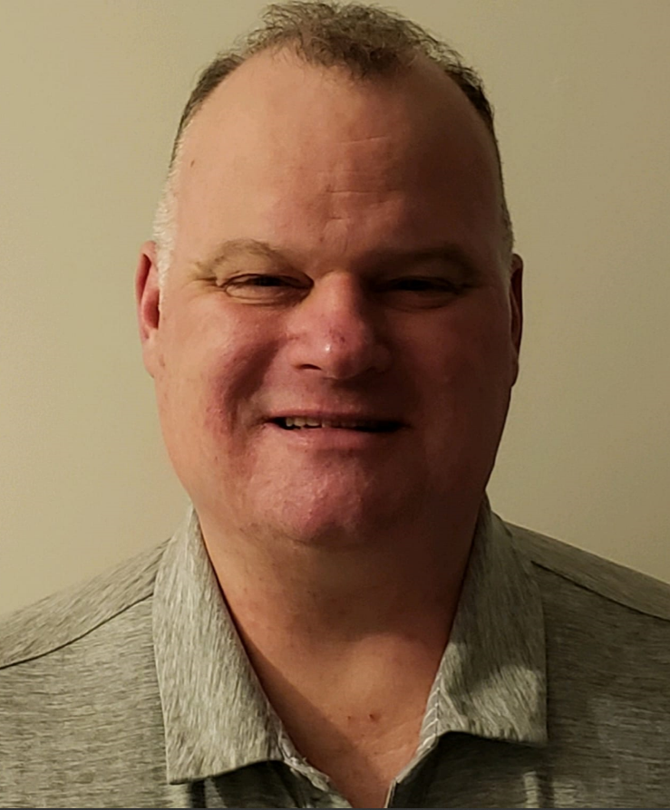

Team 3 Composition
DC
Michael Whatley
Fareeha Rahman
David Chomyn
Roger Campbell
Aaron Seemungal
Kwasi Darkwah
TDL Domain Engineer & SME | Technology Product Manager | Software Architect | MBSE Engineer | Communications, Analytics & Visualization | Principal Research & Communications Engineer
Notes:
Each step forward and present themselves

Slide 3
1. Team Composition & Heuristics
DC
Modeling Activities
Team
Composition
& Heuristics
Design Delivery
Solution Synthesis
Requirements
Problem
Definition
Manpower Analysis
Risk Assessment & Mitigation
Expert
Interviews
Jan
Feb
Mar
Apr
May
Jun
Jul
Aug

Slide 4

1.1 Personal Heuristics
Georgia Tech
Capstone
DC
Ask questions to illuminate any gaps in proposed solutions.
Surround yourself with a world-class team you can trust.
Michael Whatley - PMASE Cohort 2023
Notes:
what it is
Aids to project
Why these specific ones
- Too many unknowns from previous projects
- 9 mo + 2 yrs together brining domain knowledge across all aspects of this project, Life Derailments
- Gave ability for team to grasp the design space and domain without any prior knowledge - Mike

Slide 5



1.2 Know your Sponsor
Georgia Tech Research Institute (GTRI)
Sensors & Electromagnetic Applications Laboratory (SEAL)
Portfolio $150 million of sponsored research
Research Areas
Intelligence, surveillance, & reconnaissance (ISR)
Air & missile defense
Foreign material exploitation and electromagnetic systems
Electronic attack/electronic protection (EA/ EP).
SEAL develops advanced signal and data processing methods for :
Acoustic sensors
Multi-sensor intelligence exploitation architectures and algorithms covering all wavebands.
C3D Division
75 + persons
Communication is the glue that makes everything else operate effectively.
You can't command and control something if you have not established contact!
DC
Notes:
SEAL= (C3D) Command, Control & Communications Division led by Lee Wadzeck
C3D is the fastest growing engineering division within GTRI
C3D engineers, scientists, researchers, support folks from every C3 discipline deliver novel solutions for the Department of Defense customers

Slide 6

1.3 Capstone Project Background
DC
“The DoD needs the ability to conduct trade analysis for increased and accurate situational awareness “
“Create a reference framework and MTA Model Based System Engineering artifacts“
“Reference MTA framework to physics-level modeling of current and future sensors and communications architectures. ”
“An estimated 300-400 hours would be sufficient”
“The MTA tool should be testable“
Notes:
Complex mission impact analysis
Need of a Reference framework (Logical understanding to develop)
Identify various technology solutions required for end-to-end tool
The tool would be used to develop artifacts for strategy development
- 300-400hr est was laughable, Marshall Bronson

Slide 7



1.4 Initial Conversation 1/23/2023
DC
How do we provide assurance that the emerging technologies can be incorporated onto legacy platforms, and how do we know they will scale effectively?
Clarified Scope of Project between Framework Design and Software Design
Diagrams and relationships may have been traced by hand, which is inefficient and prone to error
Notes:
Scaling emerging technologies and legacy platforms
Existing product mids jtrs (a sotware defined link 16 Radio).
Initial Request organic(home cooked) tool
Architecture PMASE provides will be the foundation for the software that is built to follow (ref Framework)
-Drinking from a Firehose

Slide 8
1.5 DoD Mission Engineering Process
DC
ME Analysis Planning – Alignment crucial
ME Analysis Execution
Report & GRA Documentation
1
2
3
4
5
6
Problem Statement
Mission Characterization
Mission Metrics
Design of Analysis Define MTs / METs
Perform Analysis / Run Models
Document Study Conclusions
Questions
Suspected Gaps
Technologies
Concepts
Scenarios
Vignettes
ROE/CONOPS
Assumptions
Threat Laydown
and capability
MOS & MOEs – Success and Effectiveness
Quantifiable and relevant
Link MOEs:
To-down & bottom-up
Iterative Decomposition
Define Trial approaches to be evaluated
Define per trial:
Models
Data
Analytics
End-products
Define Architectures
As-Is baseline To-Be alternative
Gather Data/Models
Mission Efficacy
Sensitivity Analyses (if required)
Monte Carlo
Parametrization
Cost Trades
Confidence Level
Selected Architecture
ME Analysis Report
Curator Data / Models for reuse
Decisional Briefings
Timeframe of Interest
Repeat until desired confidence is achieved
ROE - Rules of Engagement
MOS – Measures of Success
MOE – Measure of Effectiveness
MET – Mission Engineering Thread
MT - Mission Thread
Notes:
Mission planning with the DoD found after scouring DoD de-classified documentation repositories
Easy guide for managing our project and deliverables. Includes Feedback Loops and updates
-Updating is hard, finding every place which needs attention
Systems Engineering = entire process of designing and managing complex systems,
Mission Engineering = specialized discipline within SE, aligns capabilities with its mission objectives.
Mission integration is a key part to understanding lifecycle needs of the tool

Slide 9
2. Problem Definition
MW
Modeling Activities
Team
Composition
& Heuristics
Design Delivery
Solution Synthesis
Requirements
Problem
Definition
Manpower Analysis
Risk Assessment & Mitigation
Expert
Interviews
Jan
Feb
Mar
Apr
May
Jun
Jul
Aug

Slide 10


2.1 Purpose – How did it arise?
MW
Was the Purpose at Onset or an Evolution?
Started at Onset, but can evolve into many other areas of analysis such as satellite, internet and HF pathways.
To reduce time spent building Modeling Viewpoints and understanding communication Parametrics
Who's this for?
The Stakeholders: Sponsor, Client = Stakeholders. GTRI – SEAL/C3 Division
Ultimate End Users: For C3 System operators and military decision-makers
Is this unprecedented?
No, Cyber Assassin is a tool by Systems Planning & Analysis, Incorporated.
Sponsor stated this tool is too costly for licensing needs.
Notes:
Value Prop in Gold
C3 Operators and Decision Makers use white boards, excel, power point to visualize the different viewpoints
Commercial tools like Cyber Assassin is too costly
C3D wanted an internal tool to automate and save these system views for a wider audience to use

Slide 11
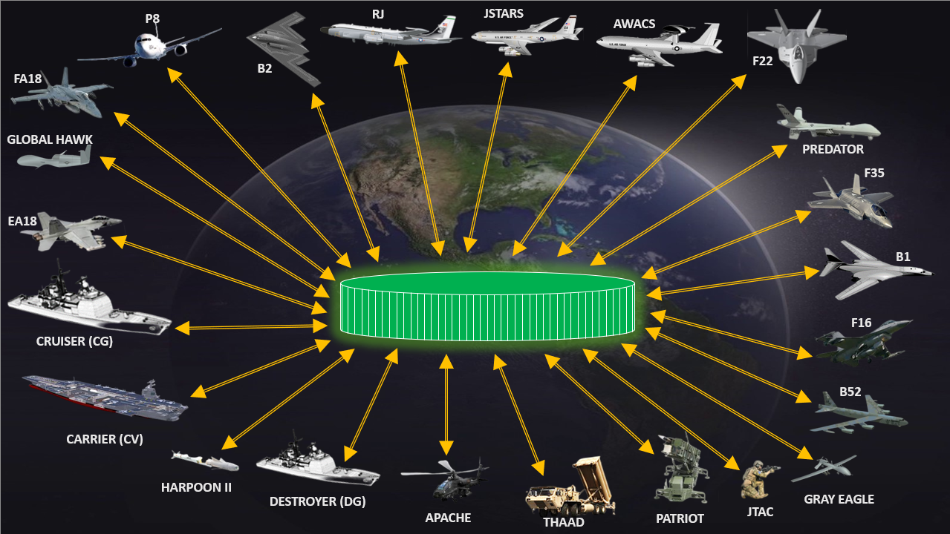
2.2 Topic Area Summary
MW
A TDL uses a data link standard in order to provide communication via radio waves, cable or satellites used by United States, Allies & Partnered nations.
Military weapons systems use TDLs.
Tactical Information
TRANSMIT | RELAY | RECEIVE
Link-16 & Link-22 are TDL architectures that use Standards such as MIL-STD-6016 and STANAG-5522.
Joint Tactical Radio System (MIDS-JTRS) is a software defined radio for Link-16.
TDL - Tactical Data Link
Notes:
Tactical Data Link or TDL uses a standard such as Link-16 or Link-22 to provide communications between military weapon systems.
How many in audience are video gamers? You know when you share the picture with other gamers. You team up and pick the best way to fight or reach the games goal to win.
TDLs work the same way. Each weapon system has a computer and display that shows the common picture built and seen by all other aircraft, ships, vehicles connected by the TDL.
TDLs transmit, relay and receive valuable information to tell them where the friends and foes are located.

Slide 12
2.3 Multi Link Environment
Link 1
Joint Family of TDLs
S-Series
B-Series
ATDL 1
K-Series
Link 11B
M-Series
VMF
IJMS
J-Series
F-Series
Link 16
JRE
V/R-Series
Link 4
Link 22
Link 11
M-Series
FJ-Series
Link 14
TTY
1980’s | 1990’s | 2000’s | 2010’s | 2020’s | 2030’s
Multiple Message Standards
Common Message Standards
MW
Notes:
TDLs have be around since 1980s.
There are multiple TDLs incorporated in the United States and Partnered Nations militaries to use and communicate with each other.
These TDLs have different message standards called series. These messages build and update the picture within each weapon systems situational display.
TDL development and limited use caused the allied militaries to reduce them into a joint family of TDLs called Variable Message Format, Link 16 and Link 22.

Slide 13
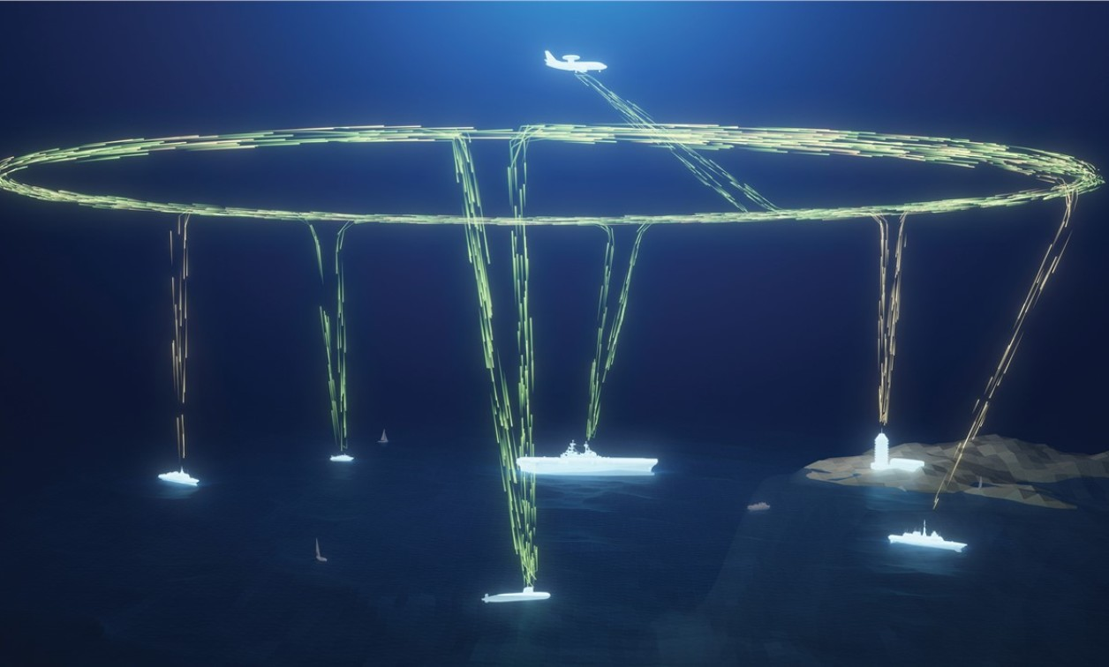
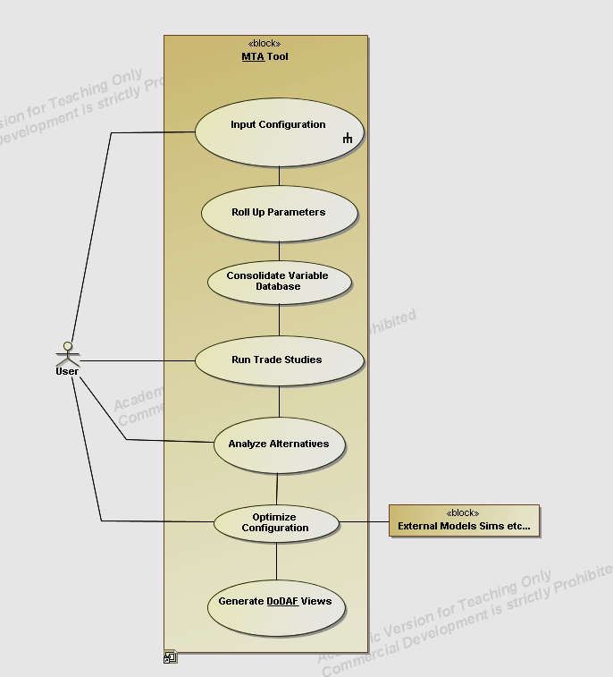
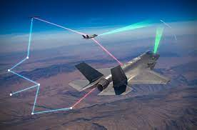
2.4 The Larger SoS
A platform that provides exchange of voice, video, and data communications between military entities- ground vessels, aircrafts, & navy vessels in real-time
Made to operate in challenging environments
Uses a combination of line-of-sight communication links and satellite
Uses standardized data formats & protocols to ensure interoperability between links
Integrates with other mission systems to bring awareness to commanders
SoS – System of Systems
MW
13
Notes:
Multi-TDL Architecture is system of systems.
TDL platforms exchange communication between different entities.
Uses a combo of LOS and SATCOM with standardized formats.

Slide 14
2.5 What needs are being addressed?
MW
Purpose of Design:
Develop an organic Link-16 & Link-22 communications analysis tool to produce DoDAF views:
OV-1 | OV-2 | OV-3 | OV-5a/b | OV-6c | SV-1 | SV-2 | SV-5a/b | SV-6 | SV-10c | StdV-1 | StdV-2
Problems
Mismatched Link-16 & Link-22 systems that do not exchange information.
Software Defined (e.g., MIDS-JTRS) and Legacy Radios miscommunications
Not all platforms have both Link-16 or Link-22 systems
No organic, low-cost tool to conduct communication analysis for C3 research projects for DoD.
DoDAF stands for DoD Architecture Framework
Notes:
DoDAF stands for DoD Architecture Framework with 14 requested views listed here.
DoDAF gives different system components like parts, interfaces, functions, behaviors to ensure sound engineering and a system that works and meets the customers needs.
Four problems identified for current Multi-TDL Architecture.

Slide 15
3. Expert Interviews
RC
Modeling Activities
Team
Composition
& Heuristics
Design Delivery
Solution Synthesis
Requirements
Problem
Definition
Manpower Analysis
Risk Assessment & Mitigation
Expert
Interviews
Jan
Feb
Mar
Apr
May
Jun
Jul
Aug

Slide 16






3.1 Literature Review
3
Professors
GTRI Knowledge Management
How did we plan and execute the research?
Examined what we could from available industry products
Identified options to research
Divided and conquered identified approaches
1
External SMEs
10
White papers
GT Library / Online Library Resources
GIT Hub
6
Professional Bodies
RC

Slide 17
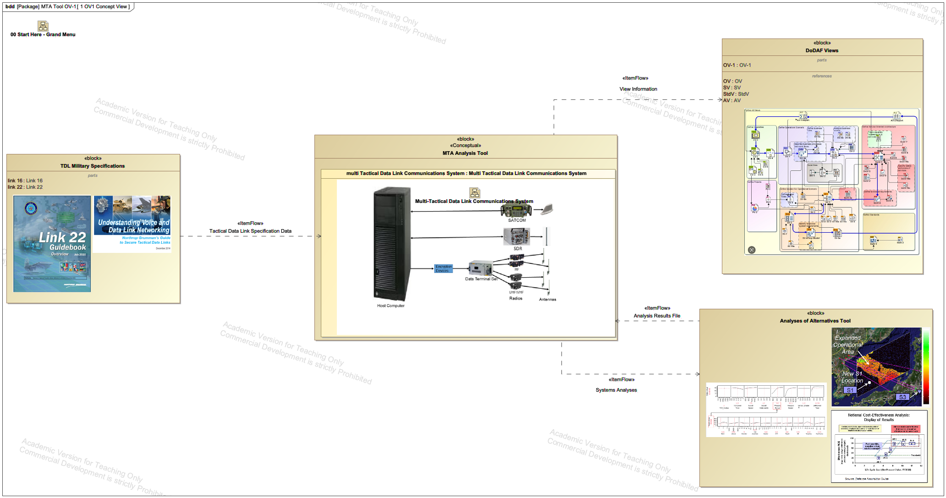
3.2 Operational View – 1 : AoA
RC
DoDAF Views
View Information
MTA Tool
TDL Military Specifications
Multi Tactical Data Link Communication System
Tactical Data Link Specification Data
Analysis Results
Analysis of Alternatives
System Analysis
Notes:
Takes in specific information:
Configurations of weapon systems
Communication systems
Perform analysis on the communication system interactions of interest
- Outputs system analysis that can be used for Analyses of Alternatives and DoDAF Views.

Slide 18
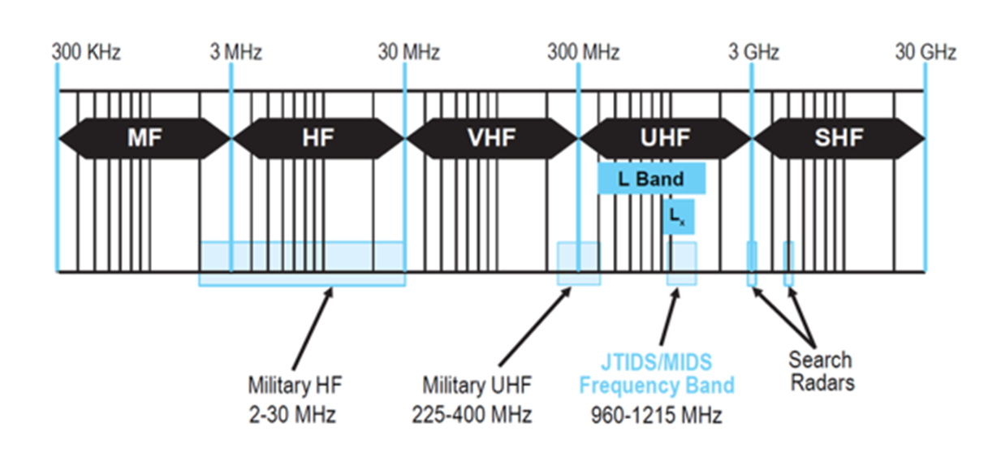
3.3 TDL Frequency Spectrum Bands
RC
Satellites operate in SHF band
High Frequency
Ultra High Frequency
Super High Frequency

Slide 19
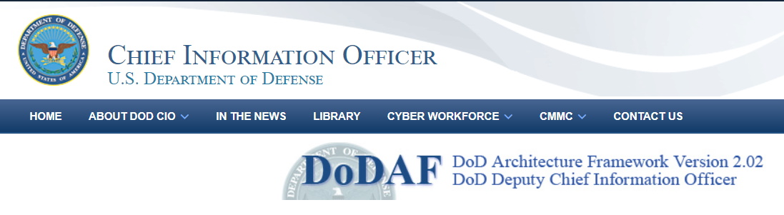
3.4 Creating DoDAF
RC
OV-1
OV-2
OV-3
OV-5a/b
OV-6c
SV-1
SV-2
SV-5a/b
SV-6
SV-10c
StdV-1
StdV-2
De-Scoped to Top 3 Views
Resource Flow Specification
(Ports?)
View Product
AV-1
OV-1
TV-1
STD-1
View Product
SV-2
SV-4
SV-6
System Functionality Description (Function?)
System Resource Flow Matrix
(Exchanges?)
Initial views requested by Project Sponsor (x14)
19

Slide 20
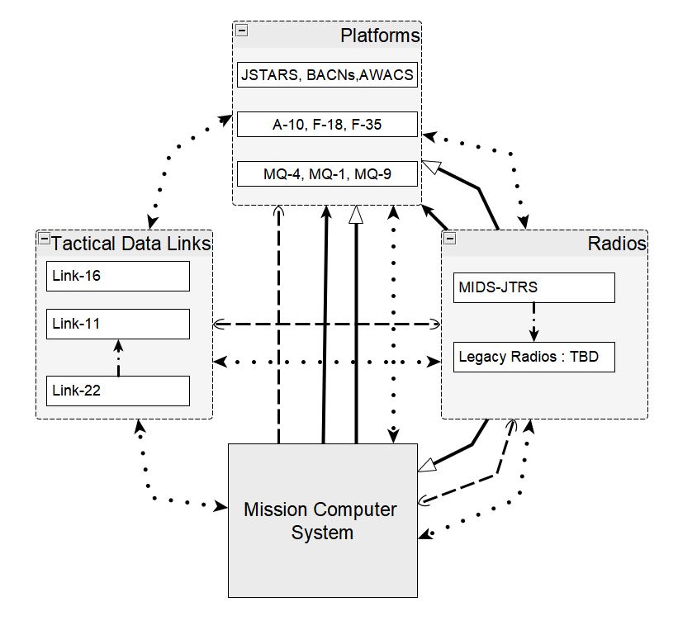
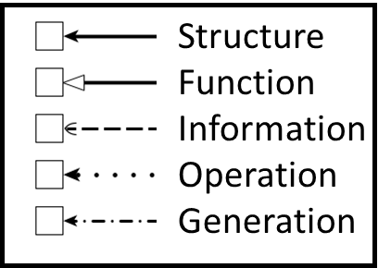
3.5 Constituent System Relations
RC
Structure:
If one is a component or basis of the other.
Function:
If one system requires certain functions or services by another system to perform its own function.
Information:
If requirements or information is exchanged between the two.
Operation:
If they are both used in an operation scenario to jointly fulfill a mission.
Generation:
If one system will be a replacement of the other.
Notes:
x

Slide 21
4. Requirements
AS
Modeling Activities
Team
Composition
& Heuristics
Design Delivery
Solution Synthesis
Requirements
Problem
Definition
Manpower Analysis
Risk Assessment & Mitigation
Expert
Interviews
Jan
Feb
Mar
Apr
May
Jun
Jul
Aug

Slide 22
4.1 Requirements
TEC | General Technical Requirements
BUS | Business Requirements
ERR | Error Handling Requirements
DBM | Database/Data Management Requirements
PTT | Production, Test and Training Requirements
PER | System Performance Requirements
SEC | Security
REL | Reliability and Availability
REG | Regulatory
S - Specific (simple, sensible, significant)
M - Measurable (meaningful, motivating)
A - Achievable (agreed, attainable)
R - Relevant (reasonable, realistic)
T - Time bound (time-based, time limited)
MoSCoW Method Requirements Prioritization
Mo
MUST HAVE - Things You can't live without
Requirement Taxonomy
S
SHOULD HAVE - Things considered important, not vital
DBM_1
Co
COULD HAVE - Good to have
Requirement Category
Requirement Number
W
WON'T HAVE - Little to no value
AS
22
Notes:
Initial Requirement analysis to get an understanding of highest value to least value requirements in the eyes of the sponsor
Collected requirements via stakeholder conversations as well as through documents shared and emails.
Smart Goals setting lead our requirements thinking as we shaped the requirements
Requirements split into several affinity groupings (Top Right) Requirement
Went back to the sponsor with comprehensive list of requirements and asked them to rate their own requirements using MoSCoW

Slide 23
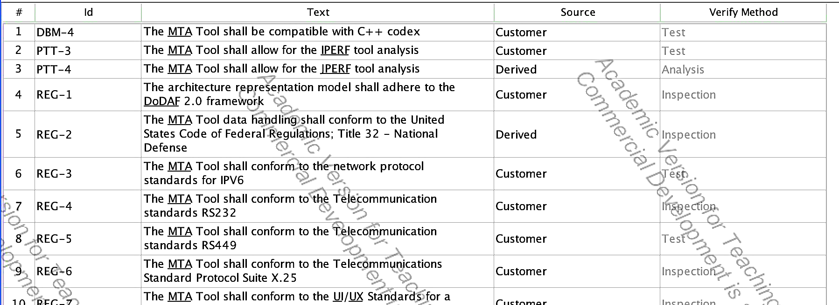
4.2 Requirements Verification
AS
Inspection | The non-destructive examination of a product or system using one or more of the five senses (visual, auditory, olfactory, tactile, taste).
Demonstration | The manipulation of the product or system as it is intended to be used to verify that the results are as planned or expected.
Analysis | The verification of a product or system using models, calculations and testing equipment.
Test | A series of inputs, data, or stimuli to ensure that the product or system will produce a very specific and predefined output as specified by the requirements.
Notes:
Talk about how we generated the rationale for each requirement by reviewing the sponsor materials and doing separate research,
e.g. what was the difference between IPERF and JPERF and how do they fit into the tool as a whole.
Discuss how we devised tests based on the aforementioned research performed and where we were unable to find documentation online, that we had to go back to the sponsor and ask for clarification.
We vetted our Rationale and Verification method with our Mentor first before approaching the sponsor.
The Sponsor provided input on how some of the niche requirements could be verified.
This was a real challenge for us
_________________________________________________________________________________________________________________
Effectiveness, Accuracy and Reliability - All of these criteria are directly related to each other. Without reliable and accurate results a model or simulation is useless. It’s the accuracy and reliability that really make the most successful modeling and simulation tools.
Testability - Since this is a tool that will be expanded upon it is essential that it is able to be easily testable now only to verify and demonstrate that the model in fact produces accurate and realistic results, but to verify the core functionality remains once future enhancements occur.
Recoverability – There needs to be an ability to analysis the model data, whether this is through logs, visualization tools or playback capability, ideally all of the above.
Maintainability and Upgradeability – As mentioned above, this tool is something that will be expanded upon to improve fidelity and potentially add additional capabilities in the future. Creating a design that allows this tool to be maintained and upgraded will be essential.
Interoperability - This tool will evolve into an application that supports distributed applications across multiple systems
Efficiency – To support the large scale scenarios that are a potential use case in this area, will need to develop an efficient design and implementation to prevent issues as we scale up
Did not make the top list but are still important:
Standards Compliance – We will absolutely need to adhere to some standards such as Link16/Link22 depending on what we are modeling, but it’s up for debate which all standards need to be implemented
Fidelity – Fidelity is important as well but for the initial design it’s ok to start with a lower fidelity and increase fidelity as this efforts grows. There will be tradeoff into how much funding we have versus fidelity level but whatever fidelity level is decided it’s important that the results are consistently accurate and reliable.

Slide 24
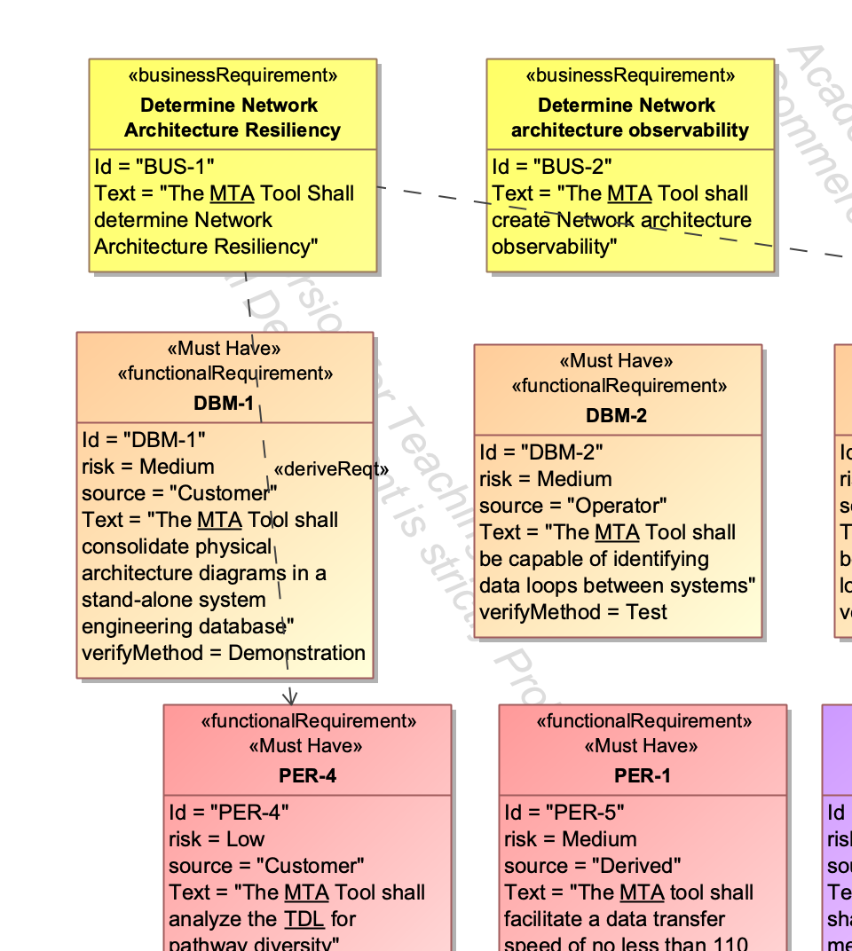
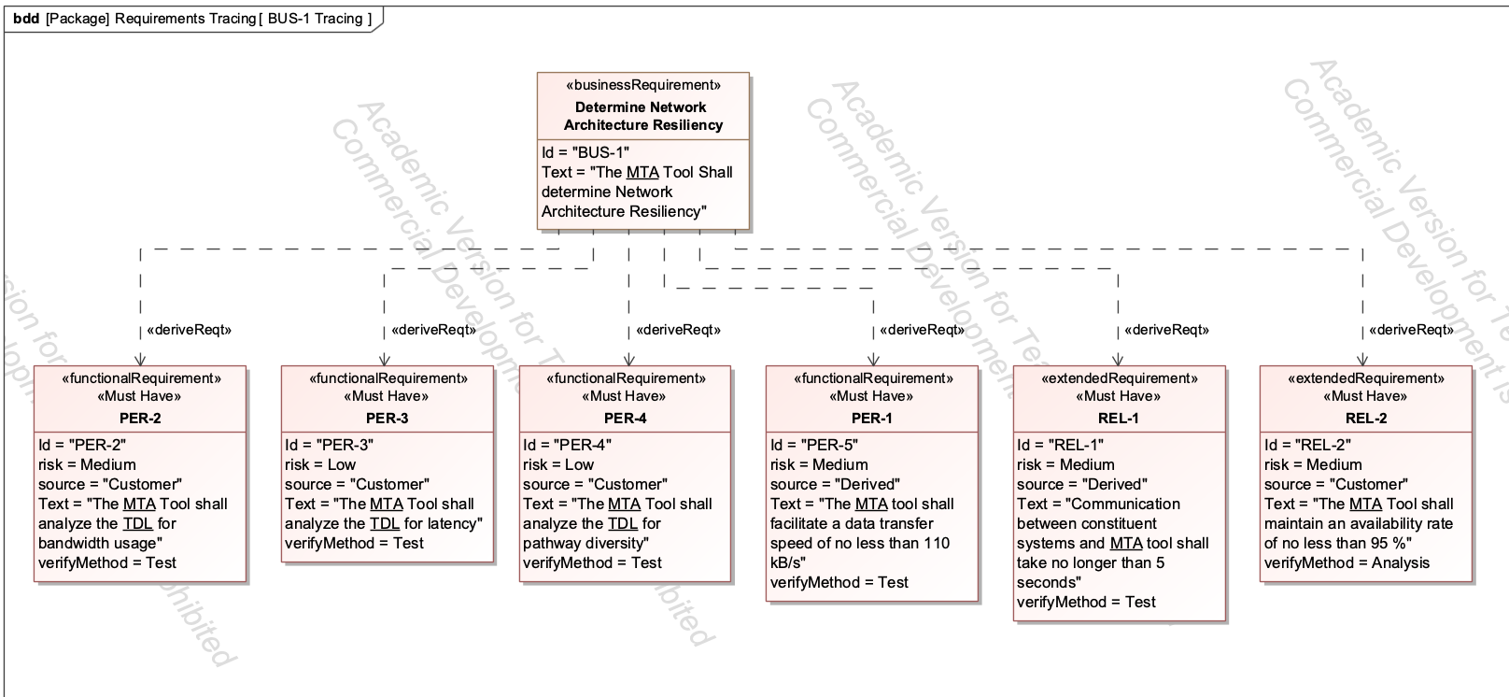
4.3 Requirements tracing
AS
Lower-Level Requirements roll up into 6 business objectives
Notes:
We ended up with a list of roughly 45 requirements and had no idea how we should prioritize them or how they were related to the Strategic objective.
We defined 6 business requirements that captured the Value / utility that this tool was trying to achieve. All initial requirements were then traced back to the 6 key business requirements.
The 6 business requirements were objectively easier to perform analysis on that assessing all 45.
The meta-requirement process rolls up the requirements into higher-level requirements that may not be verifiable but capture the essence of the lower-level requirements
This allowed for requirements traceability back to the business case and provided a solid foundation for the team to perform prioritization analysis on.
_____________________________________________________________________
Identifying and associating like requirements
Specify what deriving means
Mapping these to Objectives
~50 requirements were noted which is very tough to meet. We even had our prof and mentor comment on the likelihood of meeting these

Slide 25
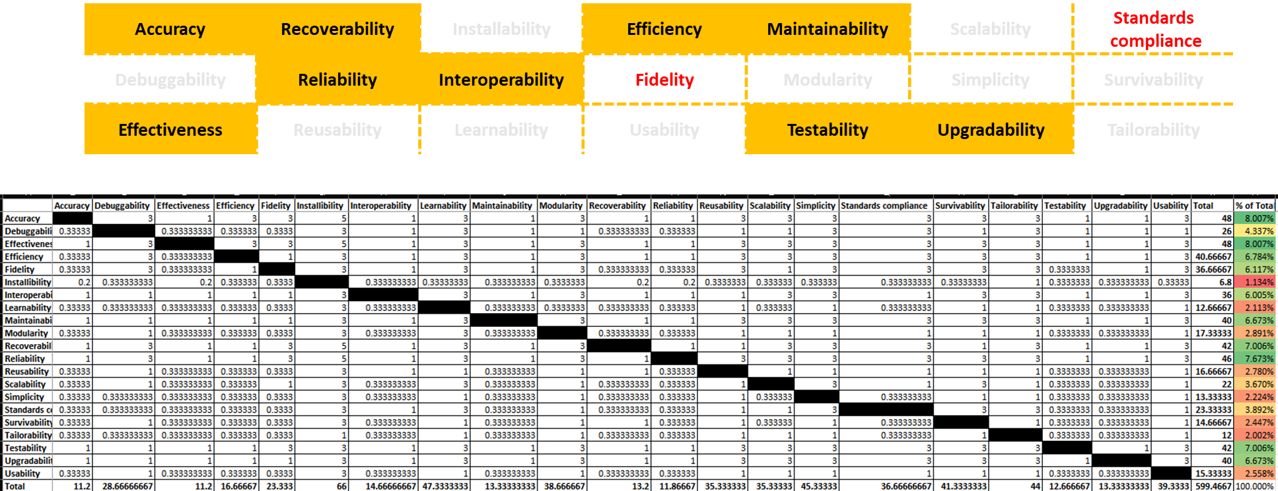
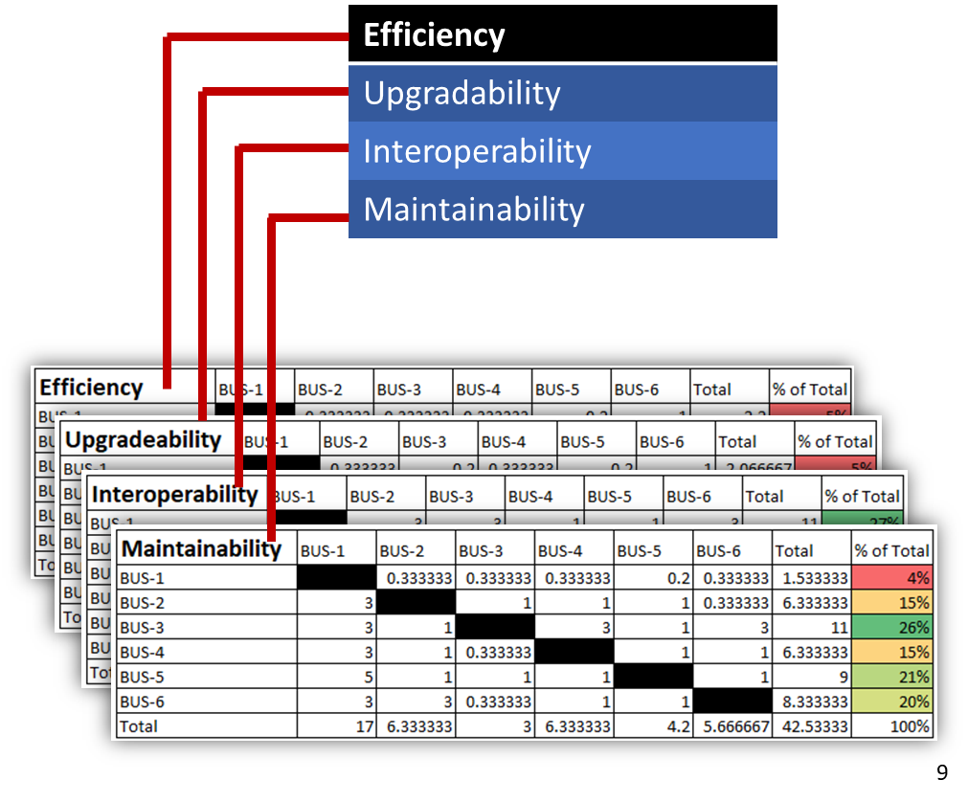
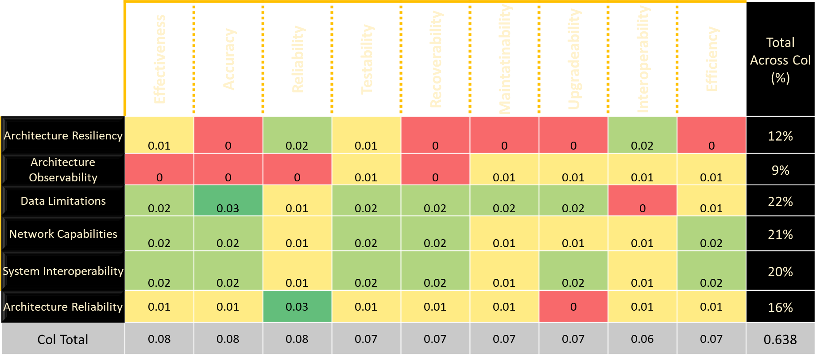
4.4 Prioritization : Analytical Criteria Method
AS
Step 1: Ranking the Criteria
Step 2: Ranking Options by Criteria
Step 4: Final Requirement Rankings
Step 3: Ranking options by all Criteria
With Risk
Without Risk
Notes:
Step 1 Prioritization Matrix:
Team 3 provided a list of 21 potential criteria
The Project Sponsor suggested 9, and this formed the basis for the AHP
They prioritized Effectiveness, Accuracy, Reliability, Testability, Recoverability, Maintainability, Upgradability, Interoperability and Efficiency as the most important criteria
Also consider Fidelity and Standards Compliance
Step 2:
Ranking options by Criteria
Step 3:
Ranking options by all Criteria
Step 4:
Presented Findings to Sponsor and mentor and then they guided us to layer in the risk assessment
Discuss big table and steps to rank requirements
Final ranking weights – describe how we determined weights and why this was important

Slide 26
5. Risk Assessment & Mitigation
KD
Modeling Activities
Team
Composition
& Heuristics
Design Delivery
Solution Synthesis
Requirements
Problem
Definition
Manpower Analysis
Risk Assessment & Mitigation
Expert
Interviews
Jan
Feb
Mar
Apr
May
Jun
Jul
Aug

Slide 27
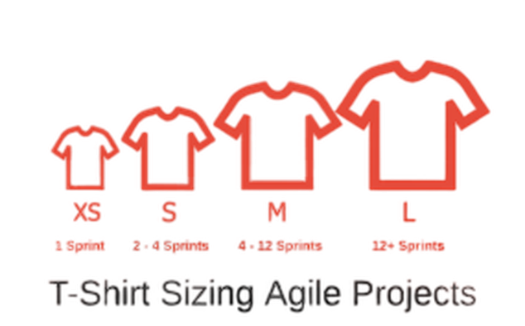
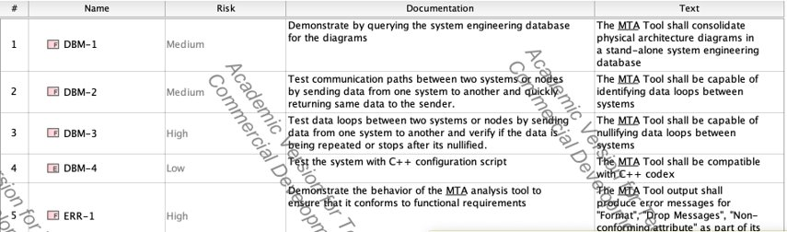
5.1 T-Shirt Sizing
KD
Notes:
Initially, we assigned risk levels to all 45 system requirements using T-shirt sizing, a qualitative risk assessment approach.
Risks were categorized into high, medium, and low levels.

Slide 28
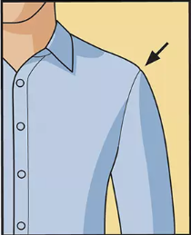

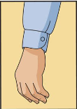

5.2 Risk Sizing
KD
NASA Risk Prioritization Matrix
7 | 16 | 20 | 23 | 25
6 | 13 | 18 | 22 | 24
4 | 10 | 15 | 19 | 21
2 | 8 | 11 | 14 | 17
1 | 3 | 5 | 9 | 12
Likelihood
Consequence
Initial Risk Assessment
Revised Risk Assessment
Notes:
Now, to help our sponsor make better informed decisions as they develop the MTA analysis tool, we decided to refine our risk assessment approach.
So, we moved from a poor-fitting T-shirt sizing approach to a more refined form-fitting one.
We selected the NASA 5x5 prioritization matrix, which is a quantitative approach.
Risks that fall in the red-zone have a high-impact and have a high likelihood of occurrence, while those in green are those with minimal impact and low likelihood of occurrence.

Slide 29
5.3 High Risk Concern & Mitigation
KD
The Team maintains a top-level understanding of the outputs expected from the tool.
Technical analyses:
1) Analysis of Alternatives
2) Discrete system evaluation
Implementing the simulations and integrating them to lower risk
Biggest Risk encountered from scoring:
Method of generating DoDAF views was researched and clarified to develop the architecture and frame the approach
Notes:
The outputs of the MTA analysis tool as expected of the project team are:
The analysis of alternatives (AoA) of the physical architecture of the TDL network.
The analysis of the interactions of the constituent systems of the TDL network.
Generation of DoDAF views
Modeling and simulation of the first 2 outputs were considered low risk, however, the generation of the DoDAF views was a challenge and hence, considered high risk. As a matter of fact, our mentor saved the day when he’d suggested that we take a step back and focus more time and efforts to find a quick solution to generate a DoD AF view as this was critical roadblock to overcome.
From a risk mitigation standpoint, our focus was on risks that required immediate attention, hence those in the red zone. We worked closely with SMEs, our mentor, and sponsor team to develop appropriate mitigation strategies.

Slide 30
5.4 Assumptions & Constraints
KD
Constraints
Available bandwidth
Harsh weather
Database storage space
Compatibility & inter-operability
Regulatory compliance
Comms systems integration
Treated as an MVP
All nodes will be identical
Flexible & adaptable
Security will not be compromised
Scalable
Limited bandwidth
Seamless synchronization
Network congestion
Key Assumptions
Notes:
For this project, there were 8 assumptions made, but a couple of notable ones will be discussed.
The MTA analysis tool framework will be developed using an MVP (minimal viable product) approach, which is the use of minimal resources and time while delivering value to the sponsor. This approach helped us focus more on key activities within the boundaries of the system’s framework to deliver the framework within the project schedule.
The MTA analysis tool will be flexible and adaptable to changing requirements and environments; this feature will allow for the tool to integrate with other external systems with the flexibility feature of the tool will also allow for system updates and upgrades.
For constraints, 6 were captured, and only a couple of notable ones will be discussed.
Harsh weather (thunderstorms, tornadoes, heavy winds, etc.) may disrupt the MTA tool’s assessment of the TDL network; this could result in some data loss.
Insufficient database storage could cause network congestion slowing down data transmission rate.

Slide 31
5.5.1 MoE & MoS Overview
FR
Measure of Success (MoS)
Shared Common Operations Picture
Execute TDL
Computer
Benchmarks
Enhanced TDL
Communications
System Traffic
Battlespace
Information
Dominance
Measures of Effectiveness (MoE)
Notes:
Personal story
Metrics measure assessment and track success and performance
How do you measure the success of the tool you build

Slide 32
5.5.2 Hardware MoE
We combine these MOE metrics into a single “score” using z-score
FR
Executed TDL
Computer
Benchmarks
Measure of Effectiveness
Enhanced TDL
Communications
System Traffic
Measure of Effectiveness
Measure of Effectiveness
Battlespace
Information
Dominance
Measures of Performance
Measures of Performance
Measures of Performance
Response Time
Utilization
Data Availability
Transmission
Bandwidth
Power
Signal Loss
Antenna
Frequency
Throughput
Electronic Warfare
Queuing Time
Battlefront
Knowledge
Encounters
Force Ratio
Protection
Relative Knowledge
Throughput
Kbps
W
m(F)
t
dB
dB
m
c
Hz
F
t
MHz
Г
Metrics
Metrics
Metrics
H,P,T’
MHz
Kbps
Г
Mbit/s
dB
ms
Notes:
Team had several meetings with Domain experts and SMEs to understand and arrive at the MOEs and the MOPs
MOPs for computer benchmarks have different metrics for measuring computer performance
MOPs for communications traffic measure the signal power, loss, frequency, rate of messages transferred etc.
MOPs for BIM are Knowledge for a military commander is the power
Situational awareness during a conflict

Slide 33





5.6 Certification (V&V)
FR
Tests conducted by an Independent I&T Team.
Verification ensures an objective set of standards is met and that no bias can interfere with assessment.
Robustness & Reliability
Performance:
System operates without crashes.
System properly handles invalid data.
How many messages can the analysis tool successfully process in a specified time interval?
Are we able to operate in Real Time?
Accuracy:
Security:
Meets stated level of model fidelity.
Test result comparisons with real world data.
Verify all message content meets MIL Standards.
(May not be taking this into consideration initially).
System maintains security & confidentiality of data
Acceptable tests for certification of a Multi-Tactical Data Link system are identified by the client/sponsor.
The tests are conducted in an unbiased manner, so no conflict of interest between systems team and testing center.
Notes:
Personal story on testing
During weekly meetings with sponsor we asked them what is it that they need to certify once the system is built
System does not crash during multiple rigorous testing
How accurate is the information being disseminated by the system – if 200 messages were sent
How many messages can the tool handle
Is this at the security level we needed
This is a big component to Verification and Validation of the designed solution. The sponsor was looking for 3rd party V&V in an independent environment without bias.

Slide 34
6. Modeling Activities
DC
Modeling Activities
Team
Composition
& Heuristics
Design Delivery
Solution Synthesis
Requirements
Problem
Definition
Manpower Analysis
Risk Assessment & Mitigation
Expert
Interviews
Jan
Feb
Mar
Apr
May
Jun
Jul
Aug

Slide 35
6.1 Capturing Behavior
Capture
Inputs
Outputs
Define
Scenarios
Use Cases
Prioritize
Measure
Attributes the artifact must produce as part of its behavior:
DC
Health Status
Bandwidth Availability
Statistics for messages sent/received
Errors: Format, Drop Messages, Non-conforming, Periodicity, Latency
Standards the behavior must follow:
· UI/UX Standards for IPV6, RS232, R449, X.25, RJ19, 1553B, USB
· J-Series & F-Series protocols
· Regulatory requirements: IPERF and JPERF
Bandwidth availability is the most important attribute for scalability as noted by the client team.
Next step here is to develop data and event flow networks to measure transfer and message bandwidth consumption from events.
Notes:
Captures some of the requirements for Software Design
Attributes help identify what the behavior should produce – Status, Availability, Notificaitons
Information found ended up not being a goal for the framework deliveries
Helps understand the important information attributes, aggregation, and security
-We captured this, but how does this tie into what the framework will do? Next slide

Slide 36
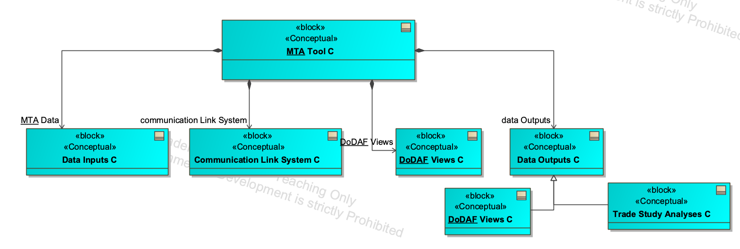
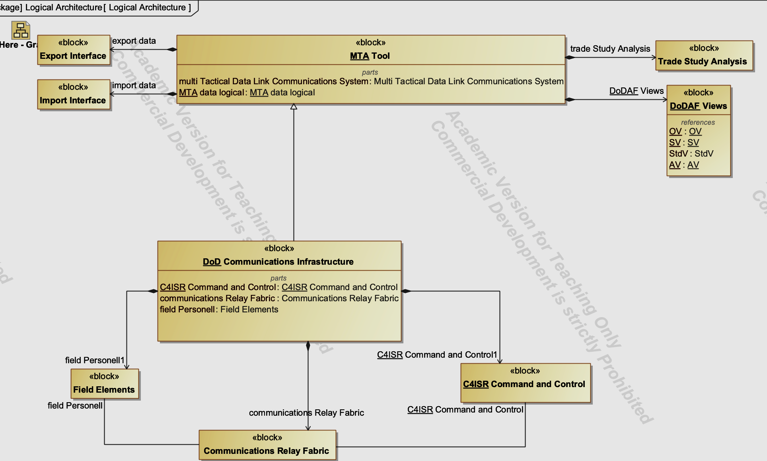
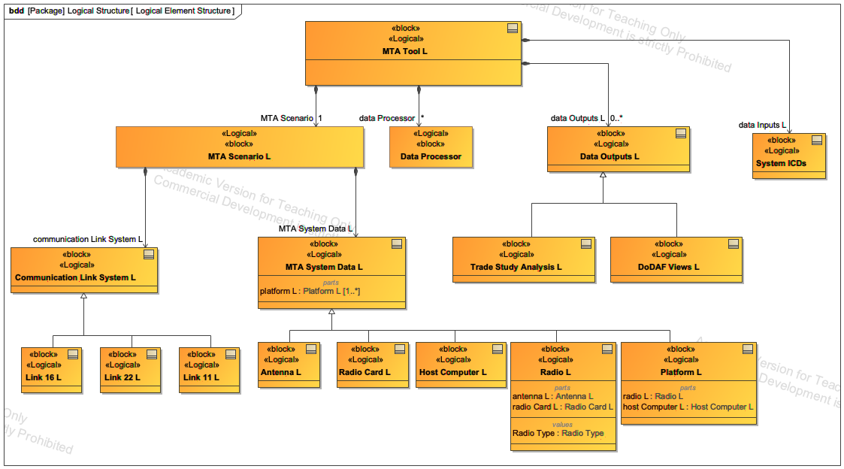
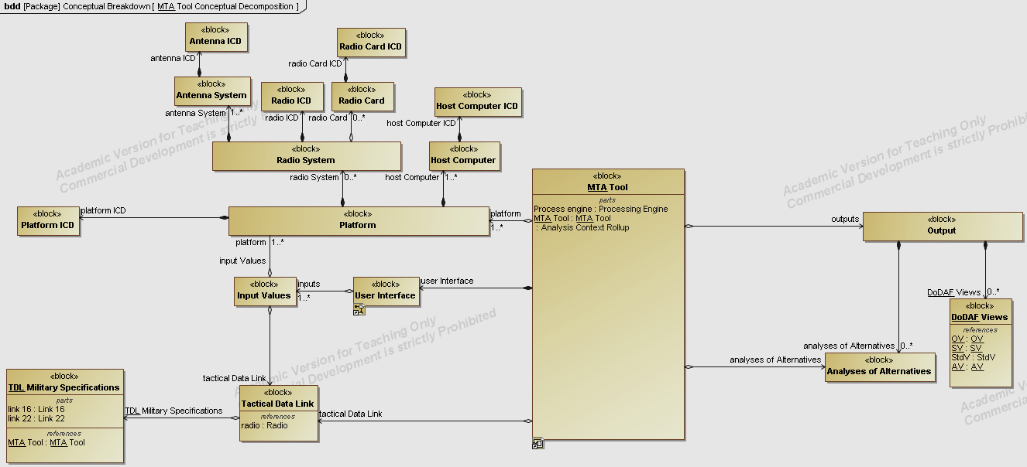
6.2 Conceptual – Logical Architecture
DC
Decomposition of the logical architecture between the tool and external component configurations
Iteration of the conceptual architecture to display the interconnections between the high-level components of the MTA tool domain
36
Notes:
Iteration after iteration
Conceptualizing how a design tool can be used to design a tool using the design tool (That’s a mouthful)
Decomposing and determining how deep we needed to go (rabbit hole)
How can someone use this moving forward? Simplification with accuracy
-Re-building our simplified model logically into behavior took countless hours of checking inputs, outputs, and data types

Slide 37
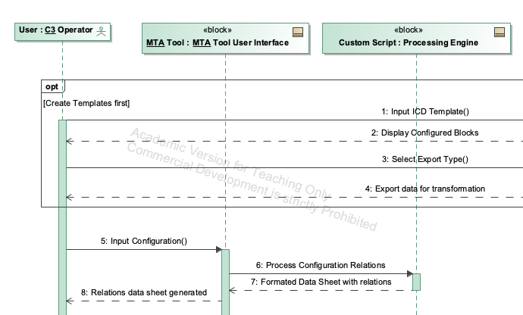
6.3 Defining behavior
DC
Activities and Ownership
Whom or what system is responsible for each activity
What information is passed between these activities
Sequencing
Interactions between systems and processes
Interaction between the operator and the Tool
(Information Flow)
Owner A
Owner B
Owner C
Owner A
Step 1
Step 2
Step 3
Step 4
Output
Notes:
Attributes of an activity and data flow
Loops, decisions, options, and duplicity
Ordering, telling and responding
-I tell UberEats to bring me food, they respond with 'order received'

Slide 38
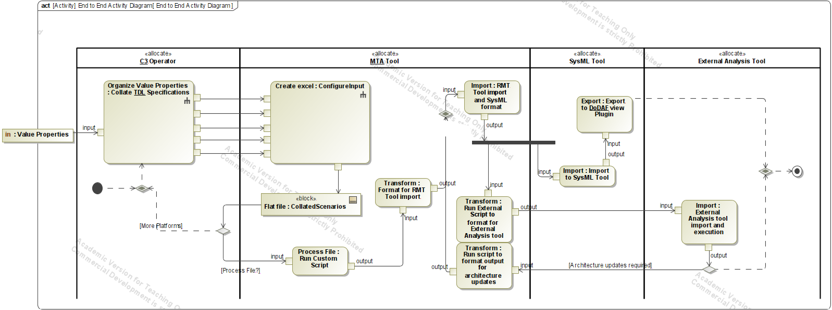
6.4 End-End Activities
Testable through Simulation
Hierarchal Activities
The conceptual architecture displaying the interconnections between the high-level components of the MTA tool domain
DC
Notes:
# of activities present as at a high-level doesn’t seem like much
Sub-Activities and using a token(like drawing a marker through a maze)
Reading and converting loops
Agnostic Analysis tool

Slide 39
7. Solution Synthesis
AS
Modeling Activities
Team
Composition
& Heuristics
Design Delivery
Solution Synthesis
Requirements
Problem
Definition
Manpower Analysis
Risk Assessment & Mitigation
Expert
Interviews
Jan
Feb
Mar
Apr
May
Jun
Jul
Aug

Slide 40


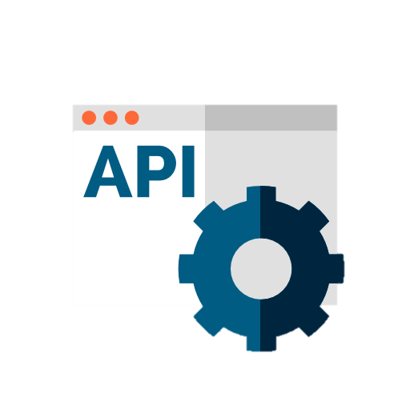

7.1.1 Market Survey | DoDAF Viewpoints
AS
Python with Plug-ins / Macros | PURE Connector | MagicDraw OPEN / JAVA API | Artificial Intelligence
- Adds new components to a host program - Extends its capabilities beyond its original design. | A description of the transformation in XML is generated XML is then used for the creation process. | Synthesizes DoDAF Views to directly work with the model data - Leverages the API functions instead of exporting and parsing the XMI file. | Use Generative AI and machine learning algorithms to create new images Based on a set of input parameters or conditions.
Notes:
As alluded to by Kwasi and Roger, one of our most challenging task / high risk items was surrounding the “generation” of graphical DoDAF views. As such we collectively decided that we should split into groups to do some research on existing tools and connectors.
Of the cuff, we were able to find an “off the shelf” solution, the Pure Connector, but upon further research, we noted that PURE is a german company. Given the nature of the tool and the fact that it is meant to be used on DoD Architectures, The sponsor ruled this option out.
When we began researching DoDAF view generation, was right about the time that Open AI released ChatGTP3 to the masses and it remains a very hot topic. Our team is a very forward thinking group and we saw how these Large Language Models were being used to create images and we tried to apply the same concept to DoDAF view generation. We had some great successes going this route, by leveraging UML instead of SySML we were able to get to an AI generated OV1. Our sponsor was thrilled that we were trying to bring innovative thinking to the forefront of their problem.
It’s funny because we ended up asking Chat GTP how it would go about generating graphical DoDAF views and it helped us write the text based UML test data.
Though there were great successes, this option was ultimately not selected as the Technology was deemed still too immature for the intended purpose, but remaining with very promising future outlook.
We considered custom solutions using open source software that had a strong business case. It could be tailor made to suit the needs of the sponsor, being built and maintained in house.

Slide 41



7.1.2 Sponsor decisions
Georgia Tech
Capstone
AS
Alternatives:
Discussion of risks and opportunities for each option
Flexibility & Maintainability
Python with Plug-ins / Macros
PURE Connector
Python with Plug-ins / Macros
MagicDraw OPEN/JAVA API
Artificial Intelligence

Slide 42
7.2.1 Final Requirements Assessment
RC
DBM-1
DBM-4 | DBM-2
PER-2 | DBM-3
PER-3 | ERR-1
PER-4 | PER-5
PTT-1 | PTT-3
PTT-2 | PTT-4
REG-1 | REG-2
TEC-1 | REG-3
TEC-2 | REG-4
TEC-3 | REG-5
TEC-4 | REG-6
TEC-5 | REG-7
TEC-6 | REG-8
TEC-7 | REG-9
TEC-8 | REG-10
TEC-9 | REG-11
TEC-10 | REL-1
TEC-11 | REL-2
TEC-12 | SEC-2 | SEC-1
TEC-14 | TEC-13 | TEC-15 | TEC-16 | REG-12
21 | MTA Analysis Tool Framework requirements met
20 | MTA Analysis Tool Software Design requirements
2 | MTA Analysis Tool Software Design requirements under further consideration
1 | Out of Scope – Geo data
1 | Additional requirement captured
Framework Reqs
Software Reqs
21
20

Slide 43
7.2.2 DoDAF Viewpoint Solution Synthesis Overview
RC
ICDs
MTA Tool
DoDAF Views
PROVIDES
DOES
ARE
Initial Capabilities Documents
System Design Documents
Scenario Information
Information Capture
Information Translation
System Capture
View Generation
View Product
SV-2
SV-4
SV-6
Notes:
Resource Flow Specification
System Functionality Description
System Resource Flow Matrix

Slide 44
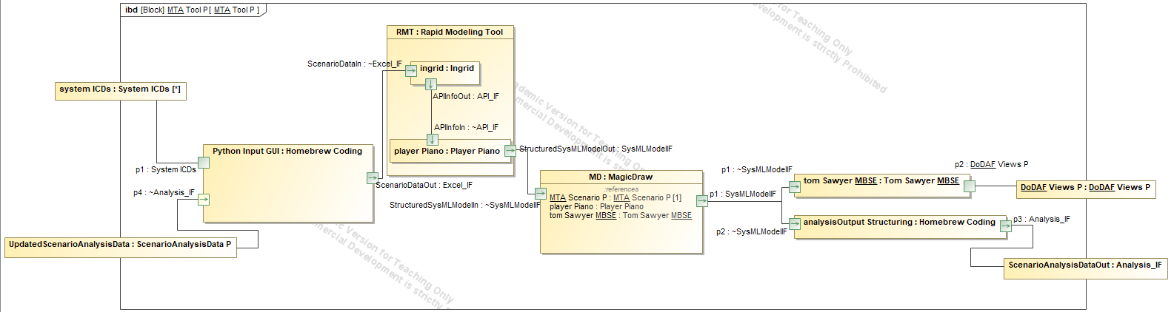
7.2.3 MTA Tool Internal Block Diagram
RC
Through Leveraging the Rapid modeling tool Tom Sawyer and Python, we capture the main necessary components that capture functionality .

Slide 45
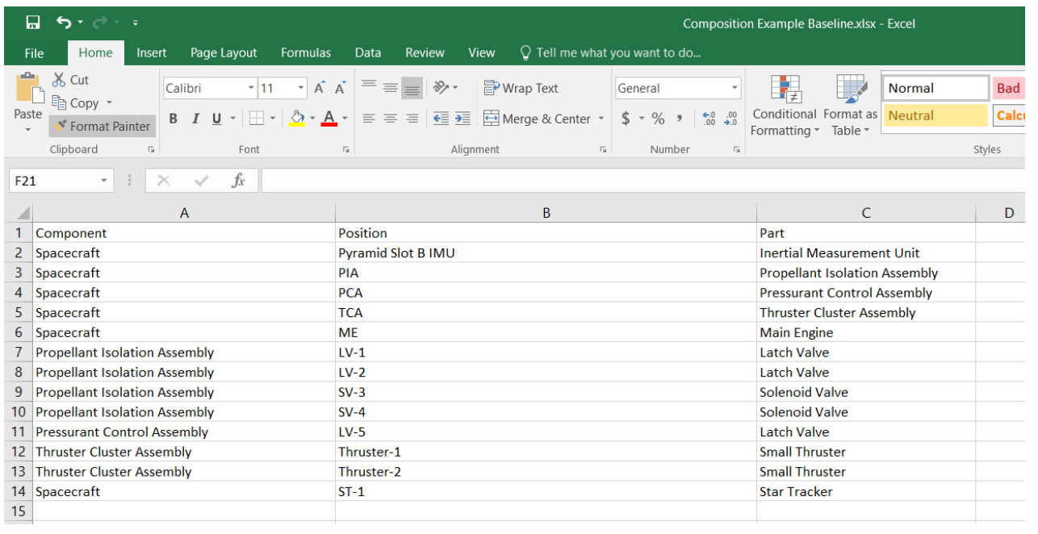
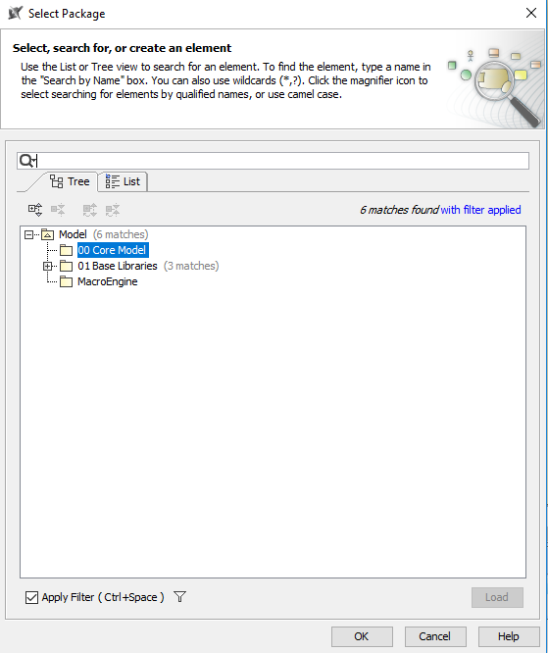
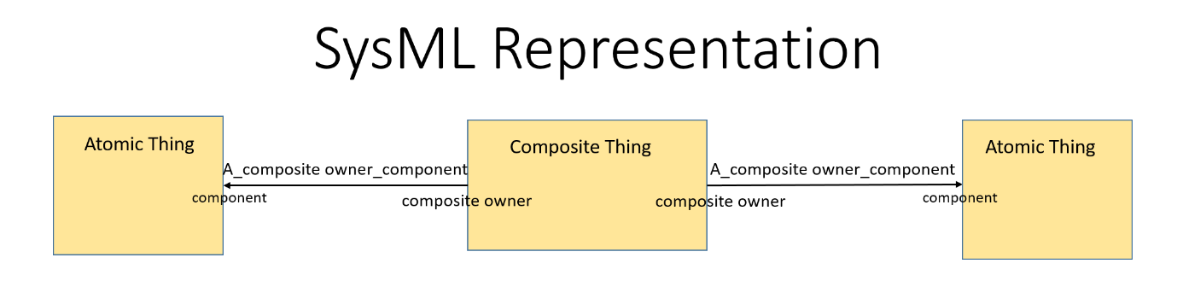
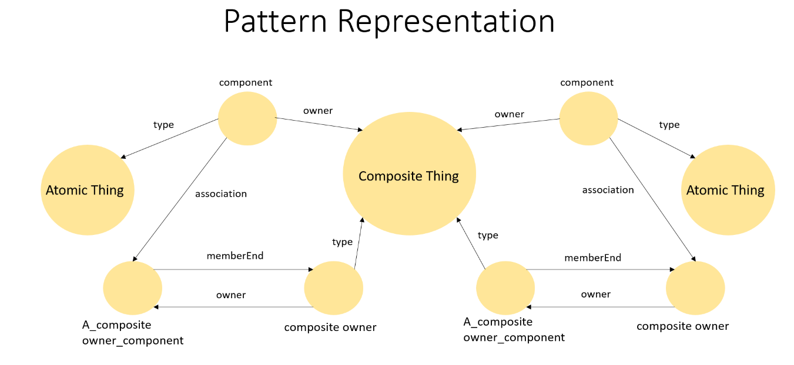
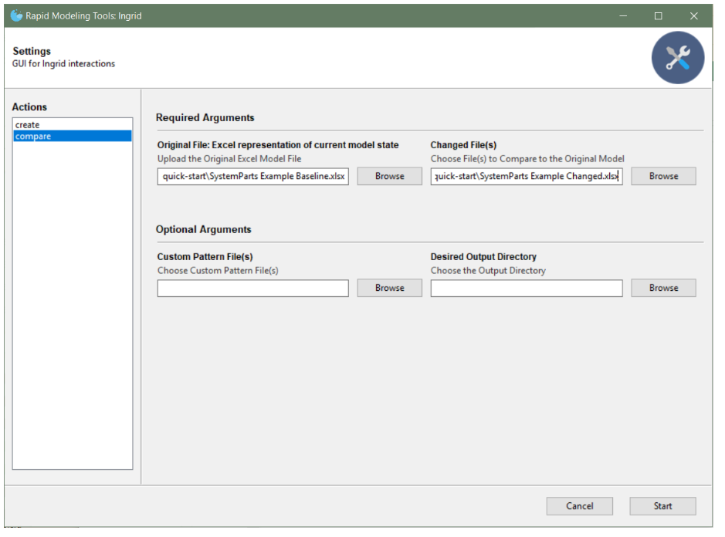
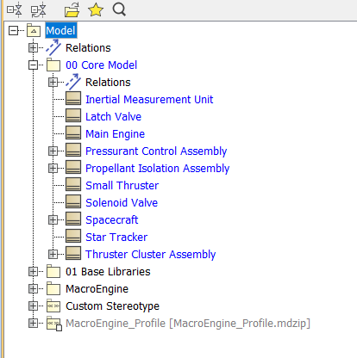
7.2.4 Rapid Modeling Tool
1
INGRID
2
PLAYER PIANO
3
RC
Notes:
Ingrid: Ingrid uses Python to translate spreadsheet data with an accompanying modeling pattern into a set of JSON instructions
Player piano: Player Piano interprets the JSON instructions as API calls to Cameo to build and maintain models
Ingrid serves as a productivity tool allowing Model Based Systems Engineers to canvas data from stakeholders and incorporate that data into their Cameo Systems Model. Ingrid fulfills these duties by analyzing an Excel file according to specified modeling patterns to create a JSON representation of the model.
Next, the Player Piano interprets the JSON created by Ingrid through a series of API calls to MagicDraw actualizing the completed MBSE artifact.
For Ingrid, a modeling pattern refers to a JSON file located in the patterns directory that describes a particular UML Metamodel.
At this moment, Ingrid has defined patterns for Composition, System Parts, Function Elaboration, Interface Data Flow, and others found HERE.
As mentioned, Ingrid uses these UML metamodel JSON files to transform the data from the human readable Excel file into a meaningful model representation.
When creating an Excel file, it is imperative to know which UML metamodel the data adheres to and to name the columns of the data according to the keys in the Columns to Navigation Map variable of each pattern JSON.
Ingrid looks for those column names, which serve as a human readable translation of the UML metamodel meaning, and maps the UML metamodel interpretation onto those headers to understand the data present in the Excel file and the remaining columns it must create to fill out the subgraph. A subgraph provides the minimal representation required to model a feature in the model that corresponds to a row in the Excel file.
The Player Piano uses the UML metadata for each model element to call MagicDraw's API translating the graph representation of the model created by Ingrid into a fully functional Cameo model.
The Quick Start covers the create and compare commands available and the common ways System Engineers use them to develop complex models in practice.

Slide 46
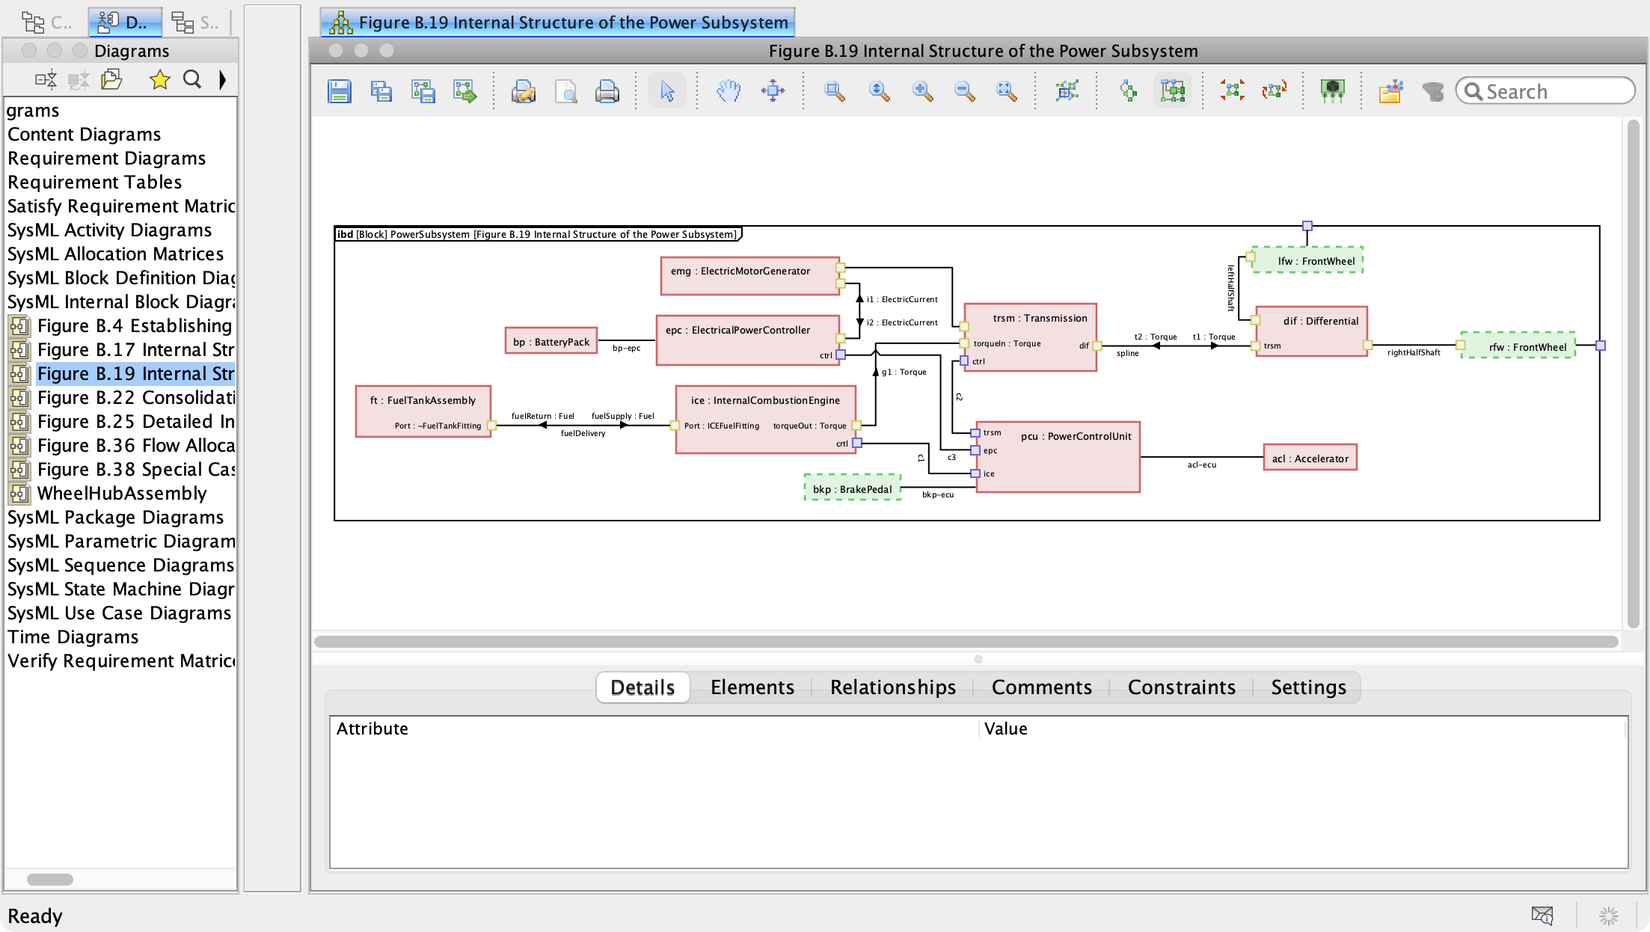
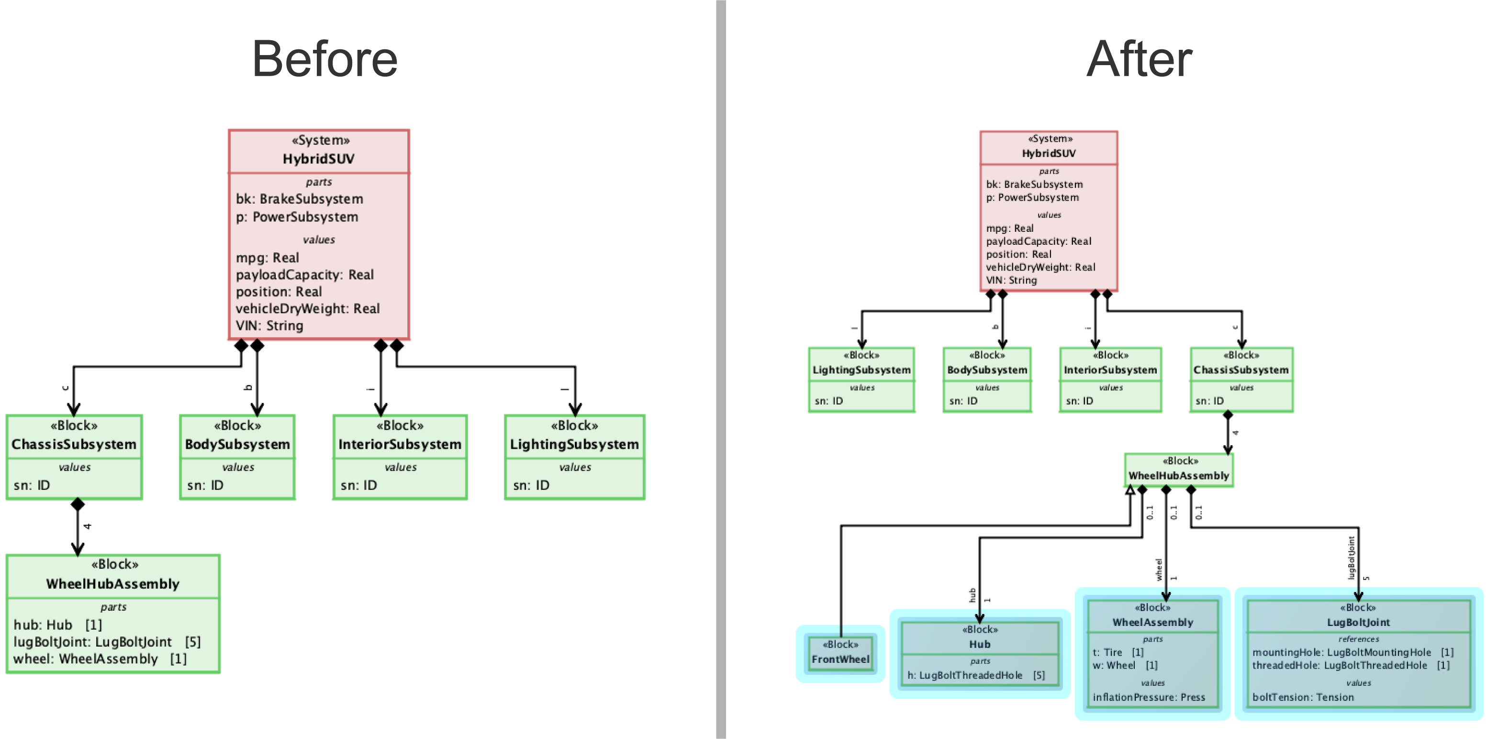
7.2.5 Tom Sawyer
Plugin that allows for automatic laying out and rendering of multiple SysML diagram types.
Tom Sawyer Perspectives MBSE Tool provides the end user with interactive features such as
Zoom
Scroll
Search
Drill-down
Drill-up
Expand
Collapse
Automatically generate SysML diagrams
Ability to load neighbors
Element centric diagrams
Ability to filter model elements
RC

Slide 47
7.2.6 MTA Analysis Solution Synthesis Overview
RC
ICDs
MTA Tool
Trade Study
Analysis
PROVIDES
CREATES
ARE
Initial Capabilities Documents
System Design Documents
Scenario Information
Scenario Generation
Initial Conditions
Scenario Export
Value Property Import
JMP
EMANE
SHACK
Other

Slide 48
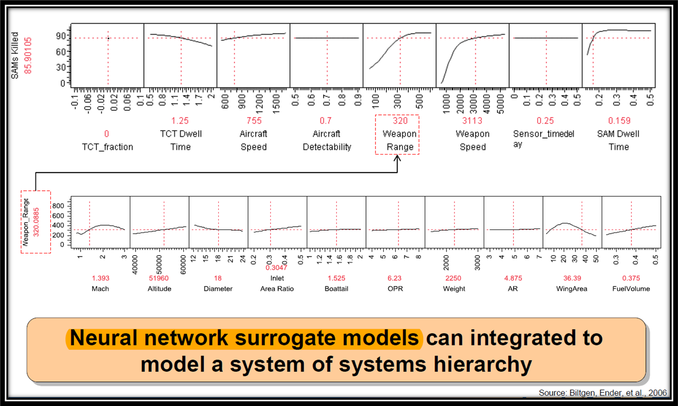
7.3.1 Surrogate Models & Neural Networks
MW
MTA Analysis Tool Metrics
General
Computer
Radio
Picture
X-Y Variables in JMP
Illustrative
Dr. Ender’s Top-down, Hierarchical System-of-Systems Design of Air Defense Weapon Thesis, 2006
48
Notes:
Surrogate Model is a mathematical transfer function used to help understand and modify physics-based equations to better show design results.
Used for finding the best fit through regression when an outcome of interest cannot be easily measured or computed.
Neural Networks created like the human brain interconnected by neurons made up of one or more layers.
The first layer is called the "input layer", it receives data from the outside world (for example: an image or text).
The last layer is called the "output layer". The data from the neurons in the output layer is read and used as the output of the network.
Multi-TDL Architecture has many different computer, communication, and information systems variables to model exactly.
I got the idea to use them from our PMASE SoS course when discussing BMDS with finding the best location for Navy missile ships to protect themselves and the island of interest.
Part of Dr. Ender's thesis used a "Reporting" determination analysis. Reporting is done by TDLs between ships.
This pointed me to think about and research how might we use this method for TDL analysis?

Slide 49
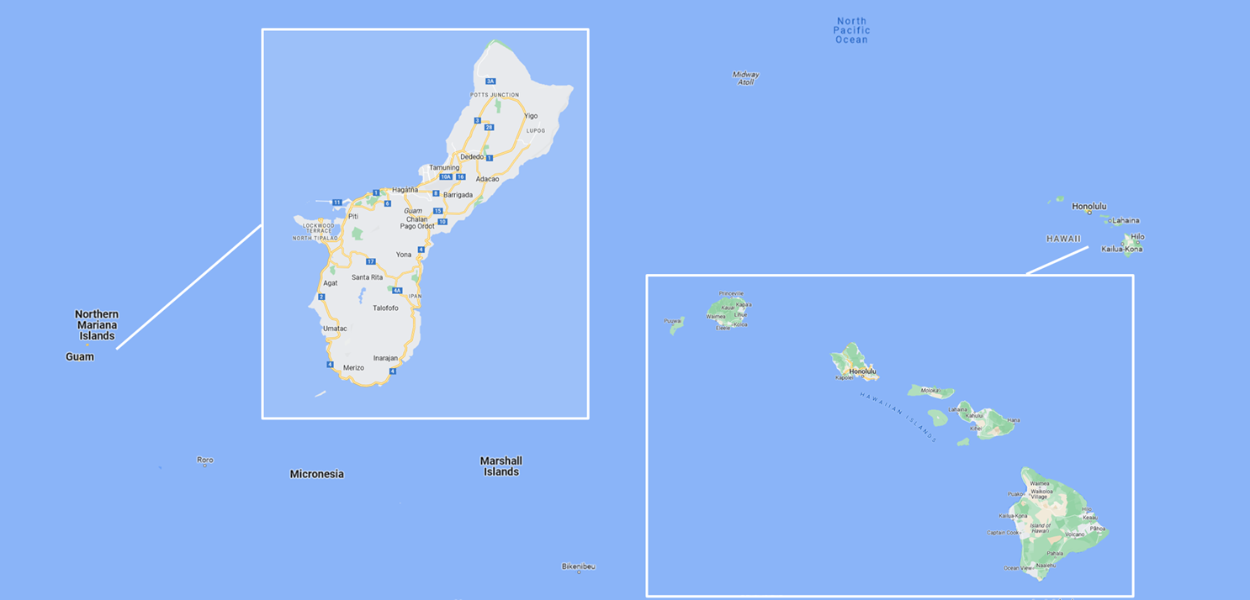

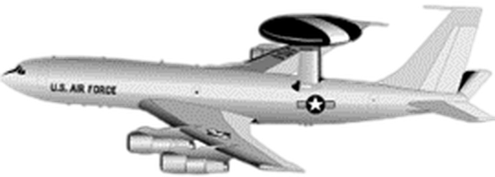
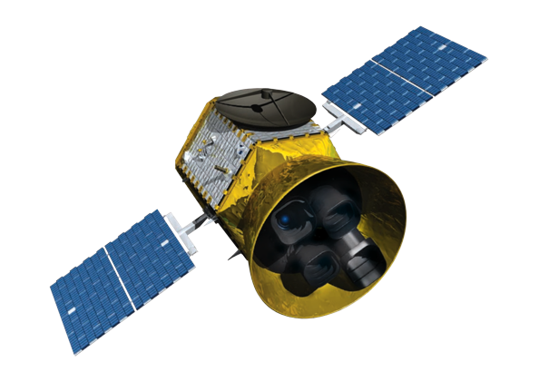

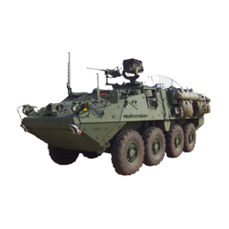

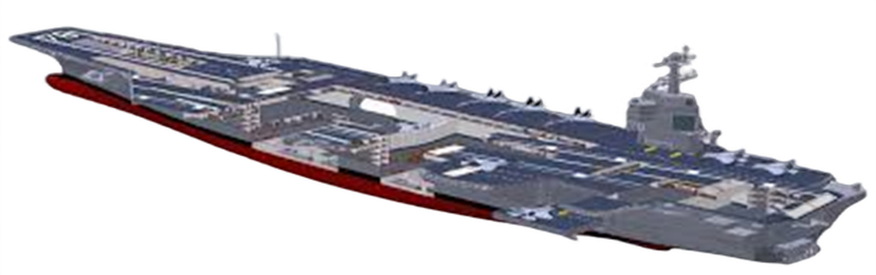
7.3.2 Scenario
AWACS
MW
Guam
STRYKER
SATCOM
HQ INDO
PACOM
Hawaii
CARRIER
49
Notes:
Multi-TDL Exercise near Guam and HQ INDO-PACOM to find out how the location, TDL frequencies, distance affect TDL Throughput.
Throughput is the maximum amount of information transferred across the TDL communication system.
AWACS aircraft, Aircraft Carrier, Stryker Combat Vehicle connected with an RF radio TDL. Aircraft Carrier connected with HQ INDO-PACOM with a satellite radio TDL.
Notice the AWACS or Stryker are not connected with satellites.
As a military JICO, I decided how to connect these different assets with same or different TDL to share the information but I used excel and white boards to make a "best guess"

Slide 50
7.3.3 How do the TDL Assets Communicate with each other ?
MW
1. Inputs Parameters
2. Output Parameters
3. Calculate Output Metrics
4. DoE via Model Center
5. Calculate responses for each DoE run
6. Generate JMP Regression model
New Throughput Equation
50
Notes:
Trade Study: How do TDL assets communicate with each other?
Latitude, longitude, altitude, distance, frequency 5) Apply DoE to calculate responses for each run.
Bits Per Second. Link-16 Throughput 30K – 238K bps and SATCOM Throughput 20T – 88T bytes 6) Find the best fit to validate your new equation.
Calculate Throughput with input parameters. Model series of equations to calculate output metrics in excel.
Import Excel into Model Center. Use Design of Experiments (DOE) to create runs 1 to many. Values used can be same/different.

Slide 51
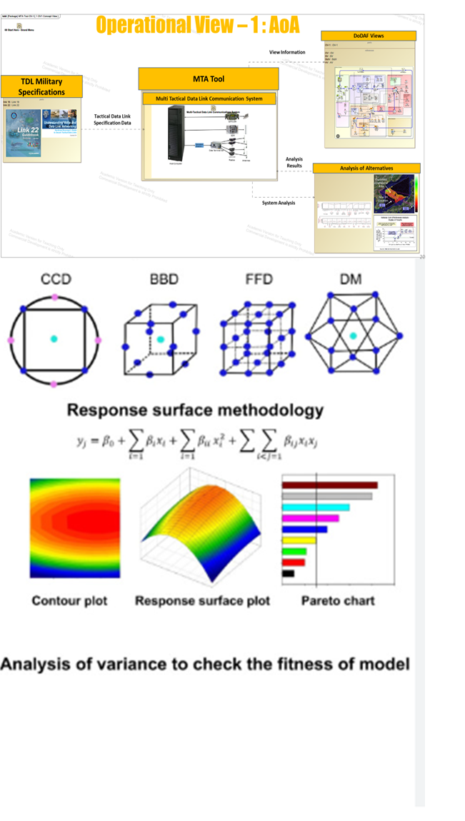
7.3.4 Throughput Regression Model Fit
MW
Response Surface Methodology
Define Independent Variables and Output Responses
Selection of the proper design
Running and measure of the response of each experiment
Verification of Model
Contour Plot
Response Surface Plot
Pareto Chart
Analysis of Variance to check the fitness of model
51
Notes:
How do we get the best Throughput Regression Model Fit to maximize the transfer of information in TDL communication system. Channel Capacity = Bandwidth x Log 2 (1 + SNR).
What happens when distance between the aircraft, ship, vehicle is increased or decreased? Does this affect throughput with more or less information received?
Look at the example Response Surface Plot.

Slide 52
8. Manpower Analysis
FR
Modeling Activities
Team
Composition
& Heuristics
Design Delivery
Solution Synthesis
Requirements
Problem
Definition
Manpower Analysis
Risk Assessment & Mitigation
Expert
Interviews
Jan
Feb
Mar
Apr
May
Jun
Jul
Aug

Slide 53
9.1 Manpower Analysis – Subsequent Build
FR
PERT
WBS
CPM
CCM
Program Evaluation and Review Technique
Work Breakdown Structure
Critical Path Method
Critical Chain Method
Notes:
Sponsors requested a decomposition of the project scope into WBS constituent tasks to help with activity identification
Personal story
Manpower analysis is forecasting, tasks, resources, cost, timeline
CPM and a CCM help understand the level of effort, resources and timeline needed to complete the project.
The cost factors will be derived from a WBS, PERT, CPM and CCM analysis for the total amount of labor hours utilized to build the Framework and to code the tool.

Slide 54

9.2 WBS – GTRI Software Build
FR
MTA GTRI Deployment
WBS Domain
2.1
Project Management
97 hrs
2.2 Infrastructure, security, backend
54 hrs
2.3 Customization and Refinement
134 hrs
2.4
Integration
86 hrs
2.5
Testing and QA
61 hrs
2.6
Production Deployment
26 hrs
2.7
Training and Support
140 hrs
WBS – Work Breakdown Structure
Notes:
The first step taken was performing a PERT analysis.
WBS – personal story
In this step, Team 3 developed a list of relevant tasks and associated dependencies from project inception to completion that are needed for developing the MTA Analysis Tool.
For PERT analysis, three types of time estimates for each subtask, namely optimistic (O), pessimistic (P), and most likely (M), were determined.
The most likely time estimate signified the realistic time achieved based on a normal turn of events.
Figure gives the WBS Tree Diagram for the MTA Analysis Tool.
The elements in each leg of the WBS tree are all unique deliverables required to create the respective project deliverable.

Slide 55
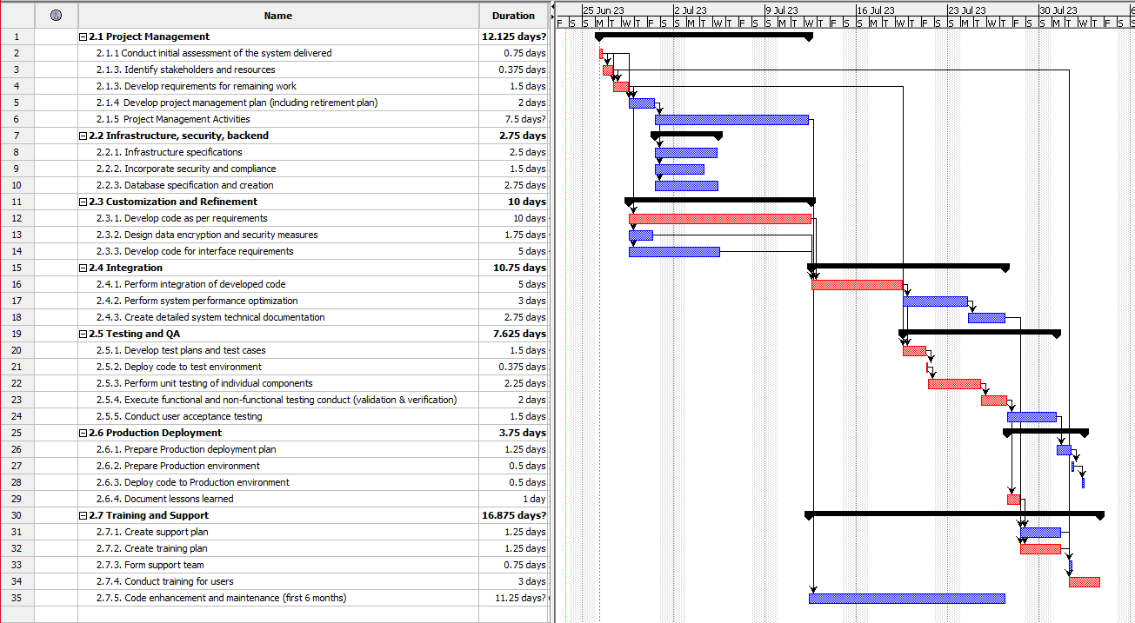
9.3 Gantt Chart – GTRI Software Build
FR
This Chart is for the subsequent software build for the Architecture Framework
Several activities can potentially be run in parallel
Notes:
This figure shows the Gantt chart of the project tasks and subtasks and the duration for each task.
It shows the dependencies as well as the tasks that can be done in parallel.

Slide 56
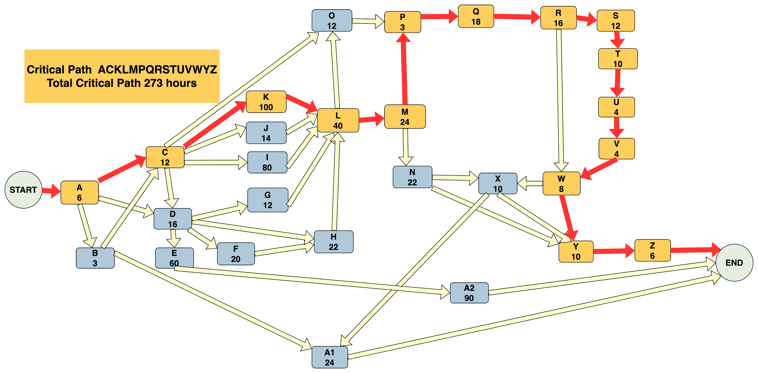
9.4 CPM – GTRI Software Build
FR
Task ID | Task | Dependency | Most Likely (M) hrs
A | 2.1.1 Conduct initial assessment of the system delivered |  | 6
B | 2.1.3. Identify stakeholders and resources | A | 3
C | 2.1.3. Develop requirements for remaining work | A, B | 12
D | 2.1.4. Develop project management plan | A, C | 16
E | 2.1.5 Project Management activities | D | 60
F | 2.2.1. Infrastructure specifications | D | 20
G | 2.2.2. Incorporate security and compliance | D | 12
H | 2.2.3. Database specification and creation | D | 22
I | 2.3.1. Develop code as per requirements | C | 80
J | 2.3.2. Design data encryption and security measures | C | 14
K | 2.3.3. Develop code for interface requirements | C | 40
L | 2.4.1. Perform integration of developed code | I, J, K | 40
M | 2.4.2. Perform system performance optimization | L | 24
N | 2.4.3. Create detailed system technical documentation | M | 22
O | 2.5.1. Develop test plans and test cases | C, L | 12
P | 2.5.2. Deploy code to test environment | O | 3
Q | 2.5.3. Perform unit testing of individual components | P | 18
R | 2.5.4. Execute functional and non-functional testing conduct (validation & verification) | Q | 16
S | 2.5.5. Conduct user acceptance testing | R | 12
T | 2.6.1. Prepare Production deployment plan | S | 10
U | 2.6.2. Prepare Production environment | T | 4
V | 2.6.3. Deploy code to Production environment | U | 4
W | 2.6.4. Document lessons learned | R | 8
X | 2.7.1. Create support plan | N, W | 10
Y | 2.7.2. Create training plan | N, W | 10
Z | 2.7.3. Create support team | B, X | 6
A1 | 2.7.4. Conduct training for users | Y | 24
A2 | 2.7.5. Code enhancements and maintenance | E | 90
 | TOTAL HOURS |  | 598
CPM - Critical Path Method
Notes:
In the next step, Team 3 proceeded to determine the critical path of the project.
To do this, Team 3 used the results of the PERT analysis to create a Critical Path Nodal Diagram. Team 3 used rectangles to represent nodes or milestones in the schedule.
Lines between key project tasks and associated interdependencies linked the nodes.
The duration of tasks in hours noted in each node.
The critical path was determined, which is the longest chain of interdependent tasks in the PERT chart.

Slide 57
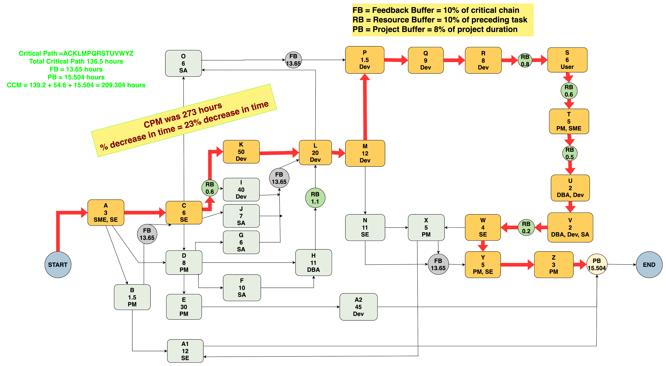
9.5 CCM – GTRI Software Build
FR
ID | Title | Role
PM | PM | Systems Project Manager
SME | SME | Subject Matter Expert in DoDAF Tactical Data Links
SE | Systems Engineer / Systems Analyst | Assess the system, analyze requirements, compatibility with external systems
SA | Software Architect | Provide the framework for the development work using DoDAF standards
Dev | Developer / Tester | Software Engineer with expertise in Python responsible for Prototyping, testing
DBA | Database Administrator | Database Administrator with some Network Admin knowledge
User | MTA Tool User | Users from DoD of the final system after its Prod deployment
CCM - Critical Chain Method
57
Notes:
Feedback received suggested applying CCM to the analysis to factor in both task dependencies and resource constraints.
Personal Story – part time full time resources
Team 3 created a list of resources needed for the project completion after the system is handed off to the Sponsors.
CCM incorporated the critical path, but also added resource buffers to ensure resources allocated by the sponsor would be available when needed.
With critical chain, the project network was tighter, and incorporated buffers for resources and feedback as well as parallel tasks, leading to an overall shorter project execution time.
Using the CCM, the decrease in project time as compared to CPM was 23%.

Slide 58
9. Design Delivery
DC
Modeling Activities
Team
Composition
& Heuristics
Design Delivery
Solution Synthesis
Requirements
Problem
Definition
Manpower Analysis
Risk Assessment & Mitigation
Expert
Interviews
Jan
Feb
Mar
Apr
May
Jun
Jul
Aug

Slide 59
12.1 Recommendations
DC
Project Artifacts
SysML Model / Framework
MTA Analysis Tool Framework Report
MTA Analysis Tool Presentation Deck
GTRI’s MS Excel RMT Documentation
MS Excel PERT Analysis Worksheet
MS Excel WBS
MS Project WBS
CPM PDF
CCM PDF
Project Objectives Met
Exceeded Expectations
Notes:
Objectives accomplished
Findings: With several low-cost industry tools already available to GRTI and some custom programming with skills already in-house, we can develop an encompassing software program to solve the business needs of the DoD and GTRI
Items recommended for the sponsor to move forward with for development
State - Over delivery, Initial funding and identified pipeline of customers for purchase of completed sys

Slide 60


Thank you
Georgia Tech
Capstone
DC
PMASE Professors & Support SMEs / Mentors
Sponsor Team
GTRI
Graduate PMASE Student Families
Graduate PMASE Student Employers
Follow the Rabbit

